Slide 1



PackGen
SeifAllah Kishtah
Presented to

Slide 2
TABLE OF CONTENTS
01
03
02
04
Definition
Testing
Describe the task and LLOs
Squish concepts on test cases
Gui App
Journey
What does packgen delivers?
Burdens and learning journey

Slide 3

01
Problem

Slide 4

Definition
This task should assess the squish testing skills ,building qt gui app I preferred to make it simple as the most work will be done at testing , since this the job description,but Implementing a qt app from scratch enhances the testing skills and give a broad understanding of the qt components

Slide 5
02
GUI APP
PackGen is a packet simulation application designed to simulate the sending of packets over a network

Slide 6

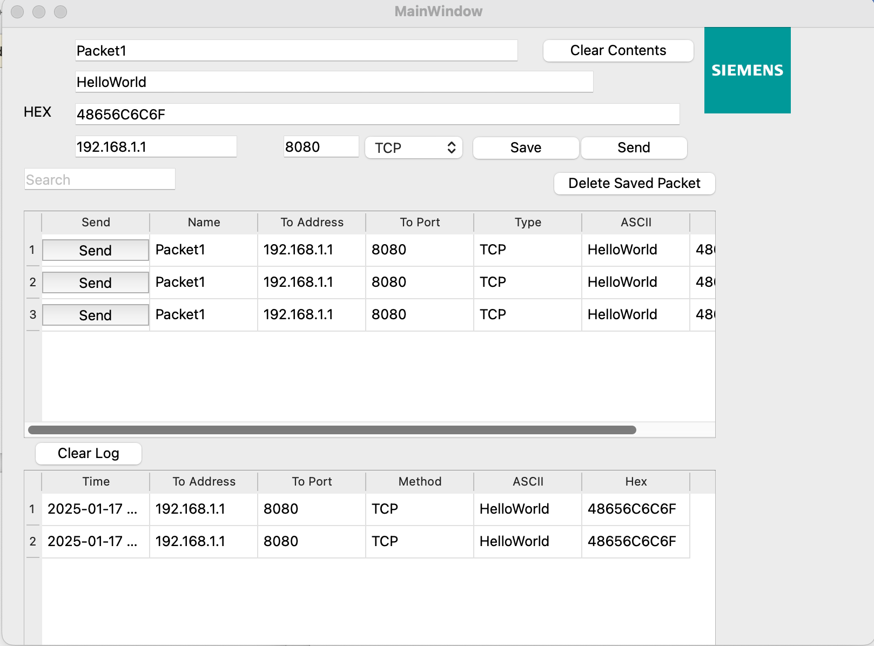
WHOA!

Slide 7
Components used
Qpushbuttons
QLineEdits
Save and debuttonslete
For text input field
Qcombobox
QtableWidget
Signals And Slots
For type input field
For showing the send and saved packets
To ensure communication between components

Slide 8
Testing
03
Squish and testsuites

Slide 9
Test Plan
BDD
Made scenarios and feature files to ensure functionalities are working
GUI Validation
Data Driven Test
Used Verification types for testing several ui components
Transformed normal test script to data driven test using test data

Slide 10
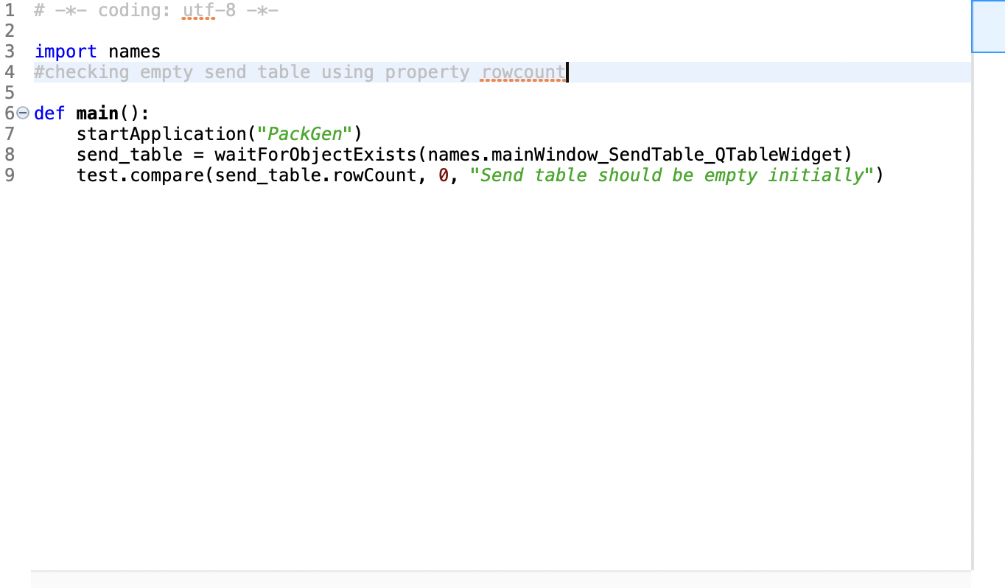
Verification Types
Squish supports various Verification Point(opens in a new tab) types to validate states of objects within the GUI and to check if an object’s property matches some expected value.
Property verification : used in tst_combobox_exist
Table Verification : used in tst_SendTableEmpty
Search Image Verification: used in tst_ImageExist
SendTableEmpty

Slide 11

Concepts used
The standard lookup functions used by Squish during the recording of a snippet are waitForObject(objectOrName)(opens in a new tab) or waitForObjectItem(objectName, itemText)(opens in a new tab). These functions wait until the object corresponding to objectName is accessible (i.e., it exists and is visible and enabled) and returns a reference to it.

Slide 12

Behavioral Driven development
Features
Steps
Files which describe the product features (or requirements) through the expected application behavior described in Scenarios
represent the actions or verifications needed to be tested in the Scenarios
Scenarios
System and platforms
are a sequence of Steps
Jupiter is the biggest planet of them all

Slide 13
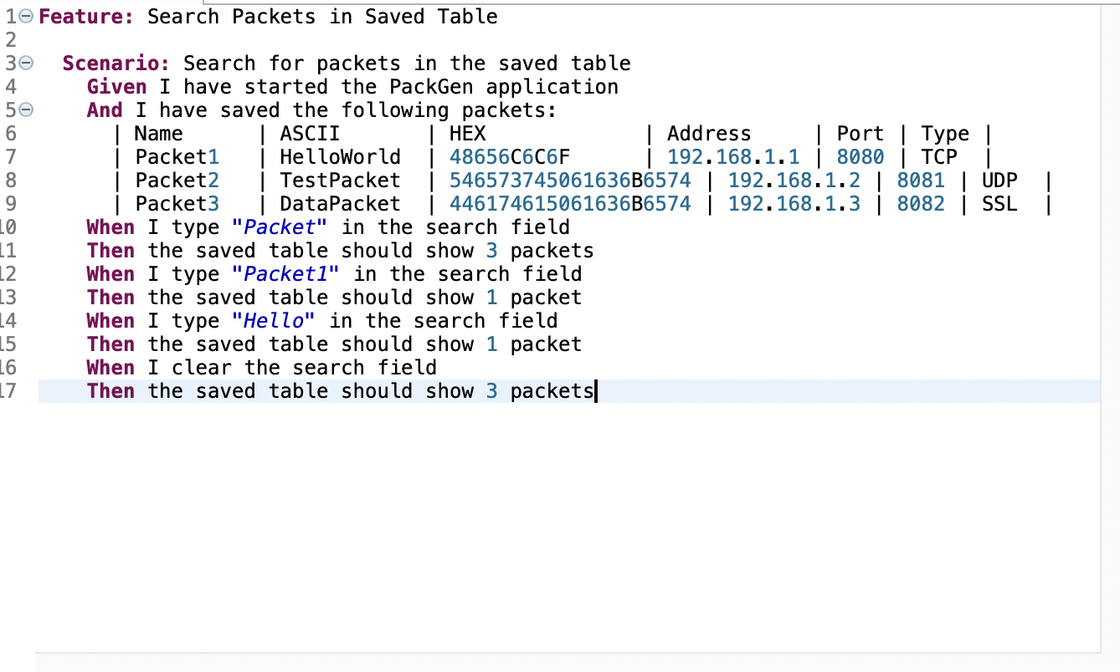
BDD

Slide 14
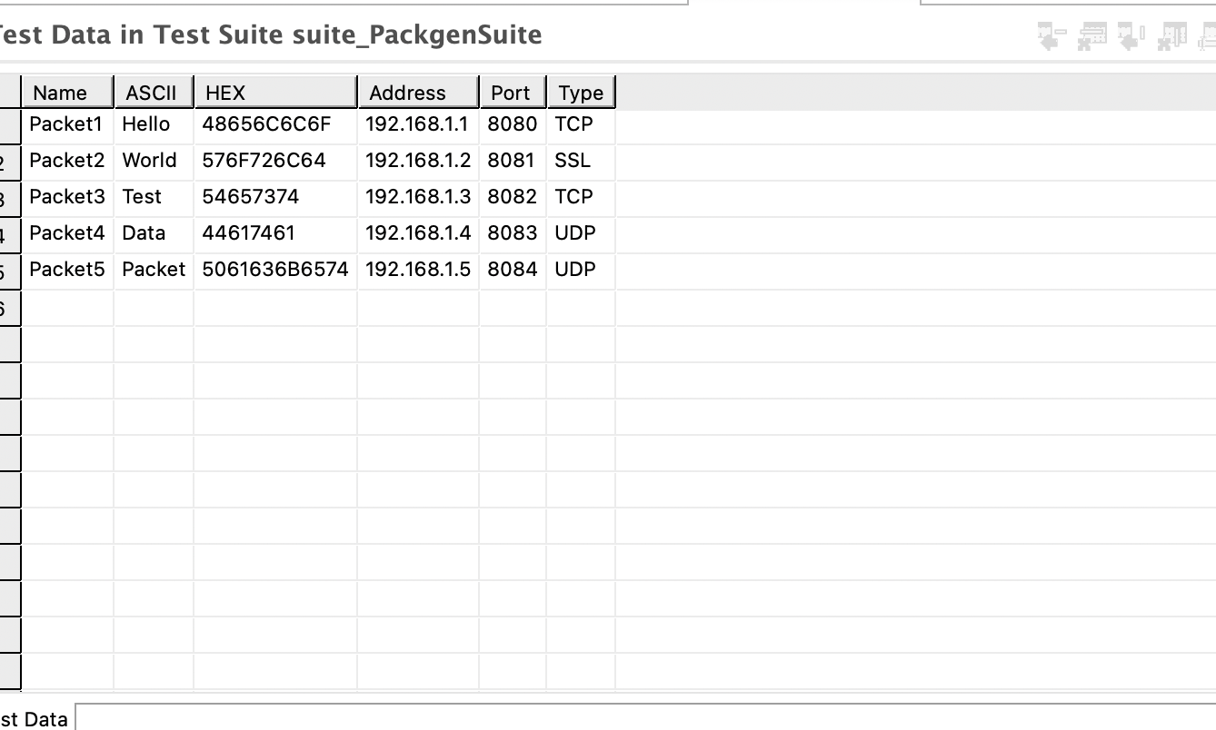
DDT
Data-driven testing is a software testing methodology where test input and output data is not written in the test script but stored in an external file that is loaded at runtime. This allows for the separation of test data and test script code when testing an AUT.
Tst_Data_Driven
Ddt test case

Slide 15
04
Journey

Slide 16
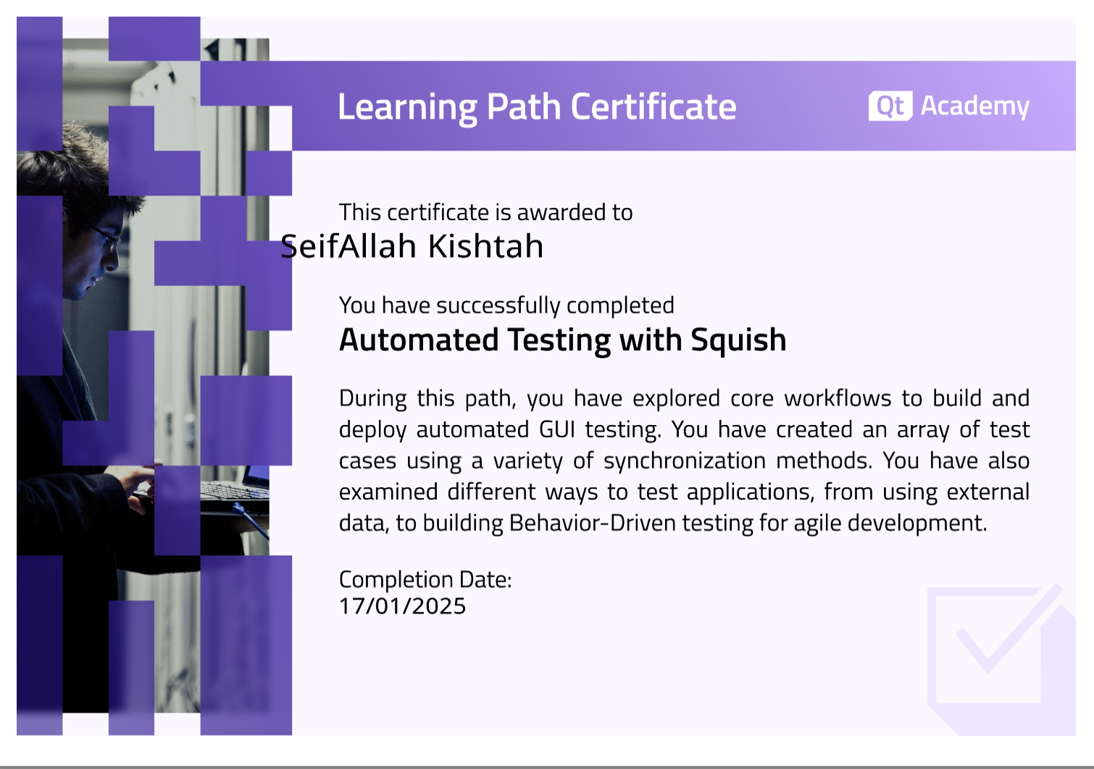
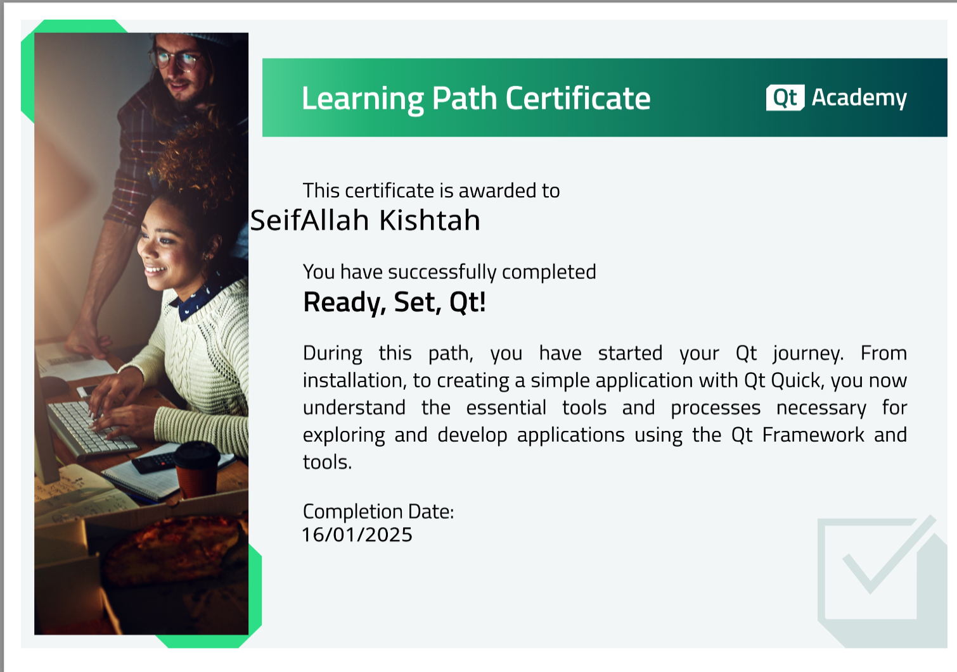
Certificates
I obtained 2 certificates from the qt academy regarding squish which was a learning path with 9 courses and qt , also finished qt beginner playlist on youtube

Slide 17
Burdens
Since my system is macos it was double the effort to setup the environments
Flaky tests
01
02
03
04
05
Finding the resources to learn squish and qt
Building files for releases and for compatible Oses
Styling readme files

Slide 18
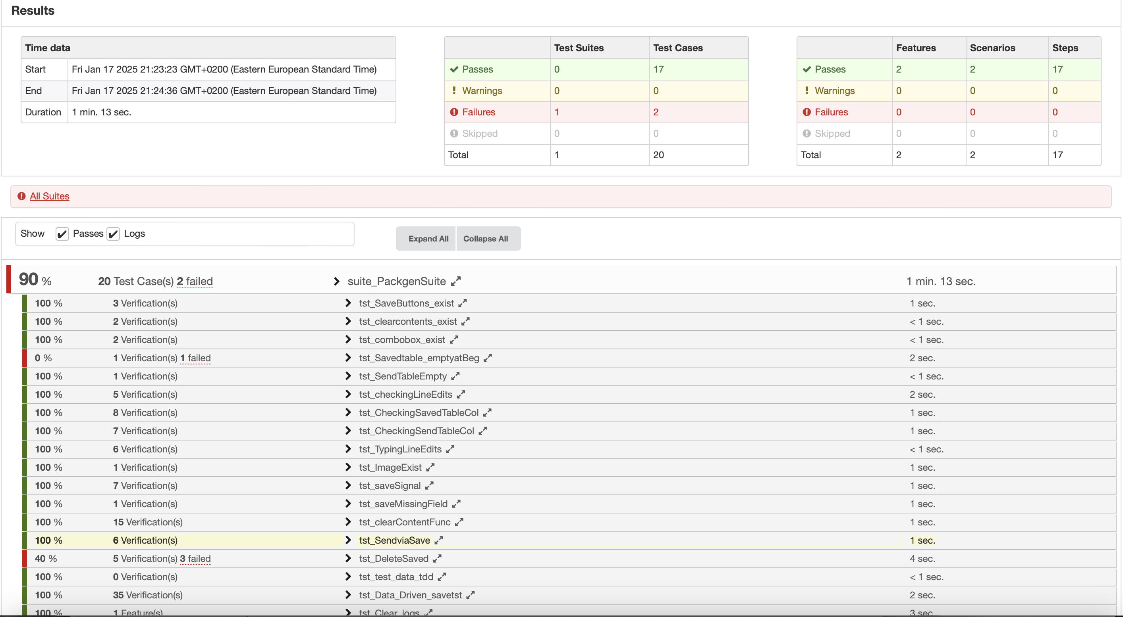
Results

Slide 19
Thank You

